Slide 1
EQUITY
- Jackin Vora
- Radhika Gathia
- Dawna Grace Raj Sathia
- Rohit Shinde
- Shrikumar Patil
- Gauravi Chaudhari
- Dhruv Patel

Slide 2
What is Equity ?
Equity is a share in the ownership of a company
Share in company profits
Raise capital in order to grow the business and undertake new projects
Common stock and preferred stock

Slide 3
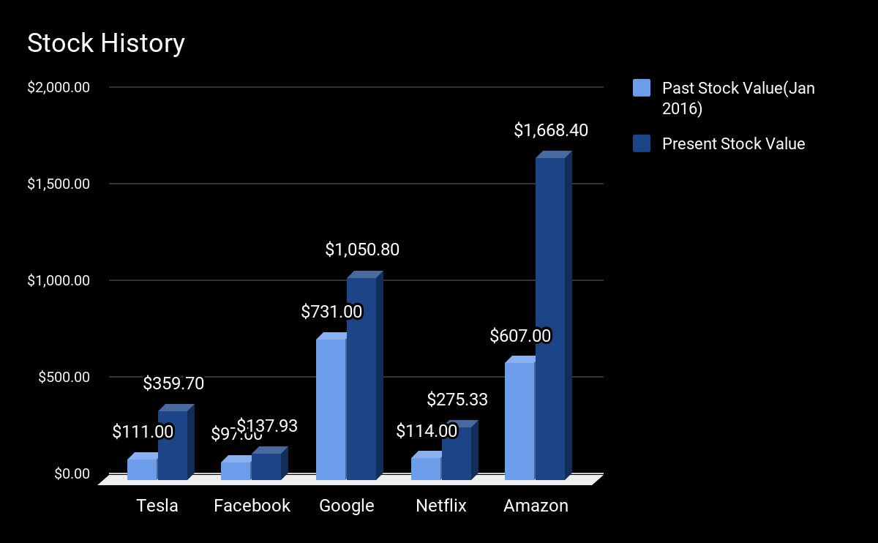
Stock History

Slide 4
Stocks Considered
Benchmark: SP 500- The S&P 500 is a collection of 500 stocks intended to reflect the overall return characteristics of the stock market as a whole
Tesla - is an automotive and energy company which specializes in electric car and has SolarCity subsidiary

Slide 5
Models Used
Bootstrap
CAPM (Capital Asset Pricing Model)
Fama-French 3 Factor Model
Last - Close Model
Kalman Filter
Volume Model
Kalman Filter
Random Forest
Trading Strategies Used
Bollinger Bands
Double Crossover

Slide 6
Layout of Strategies
Assumptions: Autocorrelation, Homoscedasticity,
Trading Strategies:
Double-crossover
A buy signal is generated when the short-term average crosses above the long-term average, while a sell signal is triggered by a short-term average crossing below a long-term average.
Bollinger bands
Consist of three bands - an upper, middle and lower band. The upper band represents overbought territory, while the lower band can show you when a security is oversold.

Slide 7
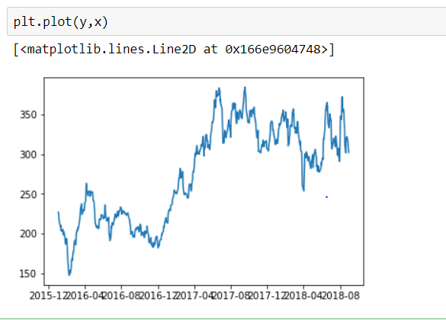
TESLA:

Slide 8
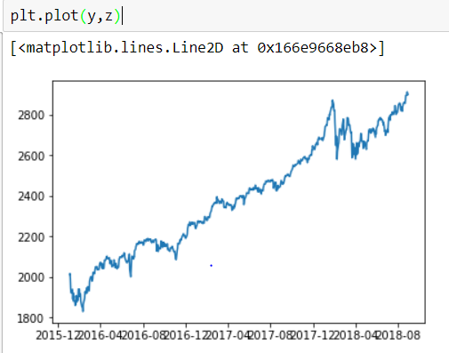
SP500:

Slide 9
Data Samples
Used observation from 4th jan 2016 to 30 August 2018
Calculated the mean for each predictor using (2*close + high +low)/4
Used bootstrap to generate 500 subsamples
Used the first 500 entries from each subsample to train the models and used the remaining 171 to test it

Slide 10
Results
Conclusion :
Returns :
Risks :
Don’t tell when selling pressure or buying pressure will end, trend may not end even after breaching the outer bands
Not suitable for certain market conditions
Does not indicate strength of ongoing trend
They are reactive indicators not predictive indicators

Slide 11
THANK YOU

